Slide 1
Muscle

Slide 2
Objectives
What is a muscle?
Features of muscles
Types of muscle
Terminology

Slide 3
Muscle
collection or group of cells which have the ability to contract
specialized for contraction and conduction
muscle fibre - structural and functional unit
developed from the mesoderm
Exception- smooth muscles of the eye (ciliary muscle, iris muscle)
myoepithelial cells
Arrector pili

Slide 4
Skeletal Muscle
Frame work- coverings
Distribution
Features
Different parts
Classification
Structure
Naming of a muscle

Slide 5
Skeletal Muscle
Blood supply
Nerve supply
Actions
Growth and regeneration

Slide 6
Distribution
Muscles attached to bones
Muscles of the tongue
Extrinsic muscles of the eye
Muscles of the upper part of the oesophagus
Muscles of pharynx
Muscles of anal canal
Muscles of lower vagina

Slide 7
Features
Fibres do not divide
Do not anastomose
Fibres show fine longitudinal and transverse striations
Supplied by somatic nerves, under voluntary control.
Respond quickly to stimuli
under control of cerebral cortex
When denervated show reaction of degeneration

Slide 8
Different parts
2 ends
Insertion
(moves when contract)
Muscle
2 proper parts
Origin
(Fixed part)
Fleshy
Contractile part
Fibrous
Non contractile
(Tendon, aponeurosis)

Slide 9
Classification
According to direction of the fibres
Parallel-
when the fibres are parallel to the line of pull
Range of movement is more but force of contraction is less

Slide 10
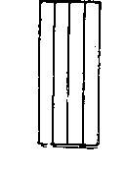
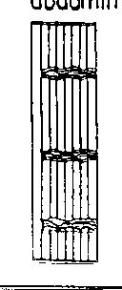
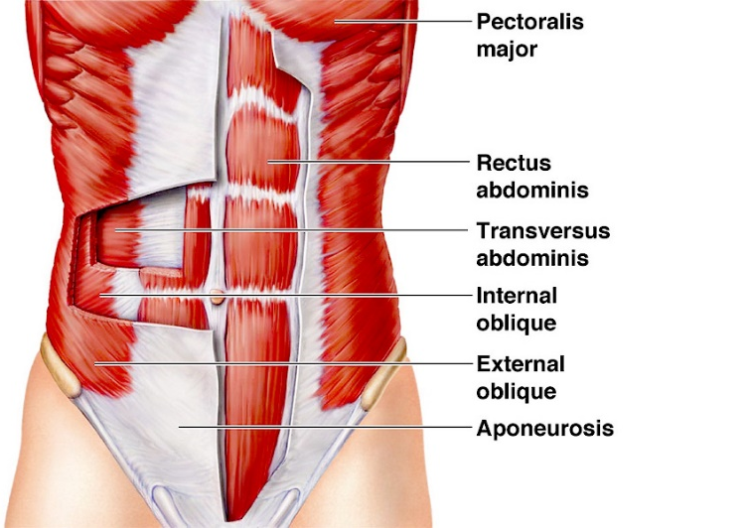
Parallel- Types
Strap like –
eg. Sternothyroid
Sartorius
Strap like with tendinous intersections- Rectus abdominis

Slide 11
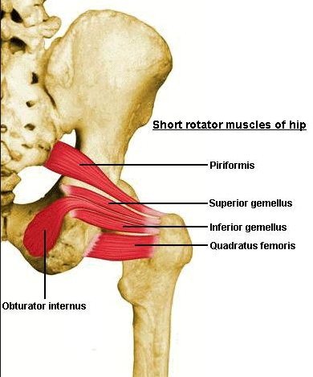
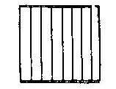
Parallel -Types
Quadrilateral-
eg. Quadratus lumborum
Thyrohyoid
Quadratus femoris

Slide 12
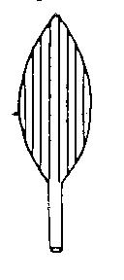
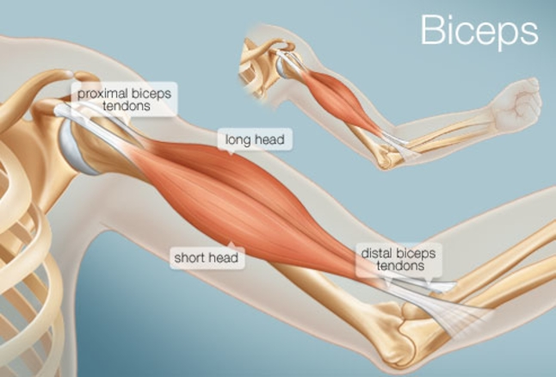
Parallel -Types
Fusiform-
Eg. Biceps
Digastric

Slide 13
Oblique
Fibres are oblique to the line of pull
Range of movement is diminished
Force of contraction is more.

Slide 14
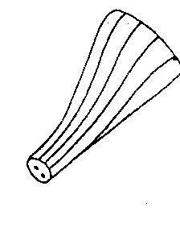
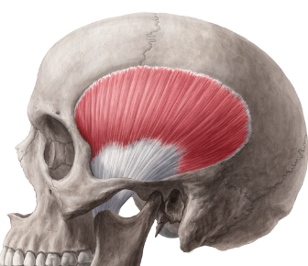
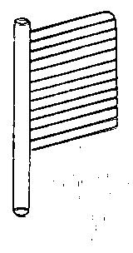
Oblique -Types
Triangular – Temporalis
Unipennate- all muscle fibres are slope on one side-
eg.
Flexor pollicis longus
Extensor digitorum longus

Slide 15
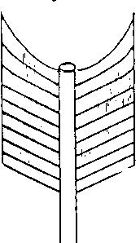
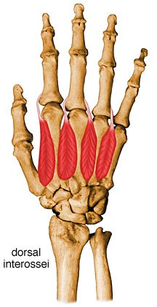
Oblique -Types
Bipennate-
central axis is the tendon
Fibres slope on each side
Eg. Rectus femoris
Dorsal interossei
Peroneus longus

Slide 16
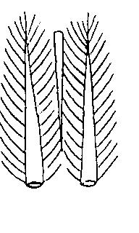
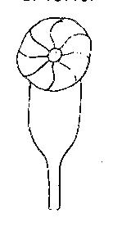
Oblique -Types
Multipennate –
Several bipennates are closely associated
Eg. Deltoid
subscapularis
Circumpennate- Tendon as central axis
Muscle is cylindrical
Eg. Tibialis anterior

Slide 17
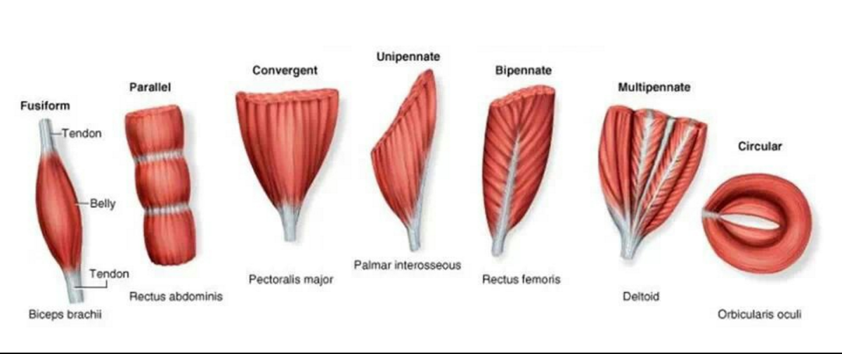

Slide 18
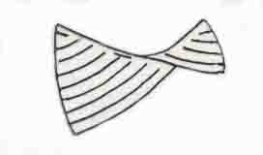
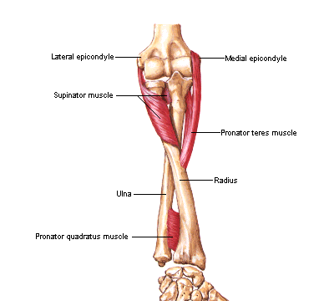
Spiral
Fibres are arranged in a spiral manner.
Eg.Trapezius
Latissimus dorsi
Supinator

Slide 19
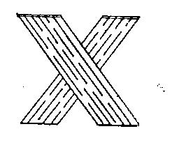
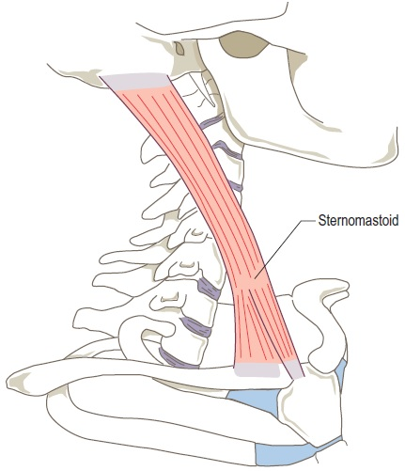
Cruciate
Fibres are crossed
Eg. Sternomastoid
Masseter
Adductor magnus

Slide 20
Naming of a muscle
According to shape- Trapezius
Serratus Anterior
According to heads of origin- 2 heads – Biceps
3 heads – Triceps
According to attachment- Sterno-thyroid
Sterno-hyoid
Sterno-mastoid

Slide 21
Naming of a muscle
According to action – Adductor magnus
Flexor carpi ulnaris
According to direction of fibres- Rectus abdominis
Obliques externus

Slide 22
Action of a muscle
Execution of a movement in a joint is the result of coordinated actions of different groups of muscles.
According to different groups of action, groups of muscles are classified.

Slide 23
Action of a muscle
Prime movers- produce desired movement
Antagonists- this group opposes the prime movers and desired movement
Fixators- This group stabilize the proximal joint of a limb to perform the desired movement in the distal joint.

Slide 24
Action of a muscle
Synergists- prevent undesirable movement in the intermediate joint when a prime mover crosses one or more joints.
Extensors of the wrist joint act as synergists during flexion of interphalangeal joints.

Slide 25
Nerve supply
Motor nerves- alpha fibres, gamma fibres, autonomic fibres
Sensory nerve-
a) myelinated fibres supply muscle spindle,
tendons, fascia
b) non myelinated fibres convey pain

Slide 26
Growth and regeneration
Number of muscle fibres does not increase after birth.
Increase in size –Increase in diameter of fibres by formation of more myofibrils.
Limited regeneration in adults.
Union between cut ends- by connective tissue

Slide 27
Blood supply
Muscular branches- arterioles in perimysium – capillaries in endomysium
Arterio-venous anastomosis- important during contraction

